Slide 1


Enhancement of Patient Demographics Query for mobile with FHIR $match
Presented by Spencer LaGesse
10 June 2024
Notes:
Hello, my name is Spencer LaGesse, and I am a member of the IHE IT Infrastructure Technical Committee. Today, I am going to tell you about the committee’s work to enhance the Patient Demographics Query for mobile, or PDQm integration profile with the capabilities of FHIR’s $match operation. I will first provide a brief background on the PDQm profile, discuss the motivation for enhancing it with the $match operation, and then provide a comparison of the existing and new functionality.

Slide 2
PDQm Background
Purpose to enable client systems to discover full Patient identity information given a set of known demographics
Original PDQ – HL7 version 2
PDQV3 – HL7 version 3
PDQm – HL7 FHIR
Not just for “mobile” applications
Originally DSTU v0.80
Now R4
Notes:
PDQm is part of the PDQ family of IHE integration profiles. The purpose of the PDQ profiles are to provide client systems with an ability to query a patient identity source to discover a patient’s record at that source given a set of known patient demographics, such as the patient’s name, date of birth, and national identifier. This capability is foundational in any healthcare information sharing ecosystem, and as such several flavors of PDQ have been introduced over time to accommodate the different needs of various health information sharing communities.
The original flavor of PDQ used HL7 V2 messages to query for and discover patient identities. A second flavor, PDQV3, was released to add this capability to systems that were architected around HL7 version 3. PDQm is the latest flavor, providing patient identity discovery capabilities based on the widely popular HL7 FHIR healthcare data exchange standard. All three flavors of PDQ continue to be supported by IHE for use in their respective ecosystems.
The ‘m’ in PDQm stands for “mobile”, which is a reflection on the need to incorporate mobile devices into modern healthcare information sharing ecosystems, as well as FHIR’s increased friendliness for mobile clients. However, it is important to note that PDQm applies to any FHIR based ecosystem, regardless of whether the ecosystem is primarily motivated by the presence of mobile devices. Many health information exchanges today are developing their exchange based on FHIR APIs, and PDQm plays an important role in those systems.
PDQm itself has undergone several large revisions since being introduced. Originally released on PDF form and based on the DSTU 0.8 version of FHIR, it has since undergone several revisions, eventually being converted to a FHIR Implementation Guide based on the modern and widely supported R4 version of FHIR. This update to PDQm is simply the latest in a long history of significant updates to the profile.

Slide 3
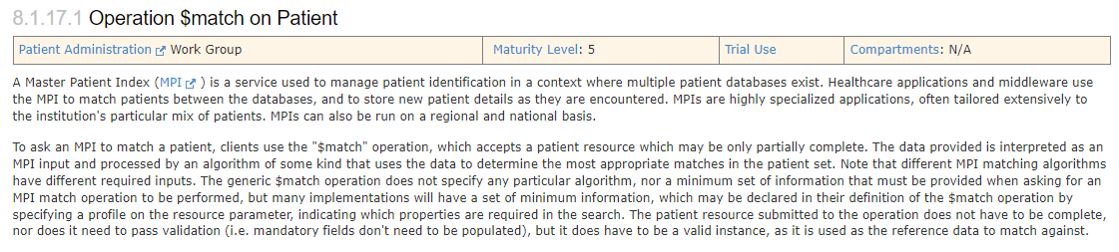
FHIR $match Operation
Historically Patient Search
Tightly defined
FHIR Operation – More Server Flexibility
Suitable for MPI style systems
$match introduced in FHIR STU3
Notes:
Prior to $match, patient discovery in FHIR was accomplished by conducting a FHIR RESTful Search against the Patient Resource. This is consistent with the typical method of discovering information in a FHIR server, and this is the mechanism that was used by PDQm prior to the inclusion of the dollar match option.
Patient identity discovery presents a unique challenge that is not always well suited to search. Some patient identity sources, particularly those marketed as Master Patient Indexes, have been developed with great investment in robust and complex algorithms for matching a set of demographics to a patient record. FHIR’s search semantics are tightly defined to allow FHIR clients to be able to reliably predict how their search parameters will affect the results they get in return. That prevents these systems from having the flexibility needed to take advantage of those capabilities. To remedy this, FHIR servers need more flexibility in how they interpret the client’s search request, determine the set of matching records, and apply business rules to the response. The FHIR operation paradigm is better suited to this need, hence the $match operation was created in FHIR STU3 to provide the ability to perform patient identity discovery with server-based logic.

Slide 4
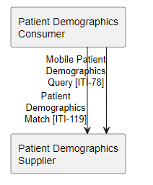
Patient Search vs $match Use Cases
Patient Search
$match
Searches for a group with a common property
Predictable Search Workflows
Identifier Based Lookup
Retrieval by known Identifier
Patient Demographics Supplier as Matching Authority
Automated workflows (e.g. backend)
Client has little to no selection logic
Heuristic Based Lookup Based on Multiple Demographics
Allowance for demographic errors
Notes:
Both the original Patient Search method and the $match operation have pros and cons, and each is better suited to its own set of use cases.
Patient Search is a good choice when the purpose is to search for a group of patients with a common property, such as a zip code. It is also a good choice when the client system wants a predictable search workflow, like when it is catering to a user that is looking through a list of patients that match their query so that they can make their own determination manually. Patient search is also the better option when the need is to look up a patient by a known identifier, such as an MRN, or retrieve a record with an already known FHIR ID.
In contrast, $match works better when the Patient Demographics Supplier, or FHIR server, should be the matching authority. This is often the case in automated workflows, such as the case of business-to-business services accessing a Patient’s record without human involvement. In this case, the Patient Demographics Supplier is in the best position to make the matching determination, since it is the one with access to the full set of potential matching patients. Conversely, clients in these scenarios often have little to no selection logic, since there is no user to analyze the results.
$match also works well when a heuristic search based on multiple demographics is desired. The Patient Demographics Source can evaluate the provided set of demographics as a whole to determine the best possible match rather than relying on element-by-element filtering done in searches. This also improves matching in cases where there might be errors in the demographics supplied in the query, such as a nickname rather than a legal name, or transposed digits in an identifier.
Because both sets of use cases are important and valuable, this enhancement to PDQm supplements the existing search behavior with new $match capabilities, rather than replacing search entirely. Each method can be used for the cases where it is most well suited.

Slide 5
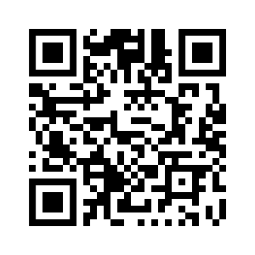
Patient Demographics Query for mobile Version 3
Now in Trial Implementation
https://profiles.ihe.net/ITI/PDQm/
Feedback can be submitted at
https://www.ihe.net/ITI_Public_Comments/
https://github.com/IHE/ITI.PDQm/issues
Notes:
Thank you for taking the time to learn about the recent enhancements to PDQm, which are now available for trial implementation. We hope you will find this enhanced version useful in accomplishing your healthcare interoperability goals. Thank you!

